Slide 1
Android Security
GROUP MAY 1208 Alex Frisvold Alex Meyer Nazmus Sakib Eric Van Buren

Slide 2
Advisors
Our project is through The Boeing Company and our advisor is Victor Lukasik, the manager of Boeing’s Cyber Mission Assurance group
Our faculty advisory at Iowa State is George Amariucai

Slide 3
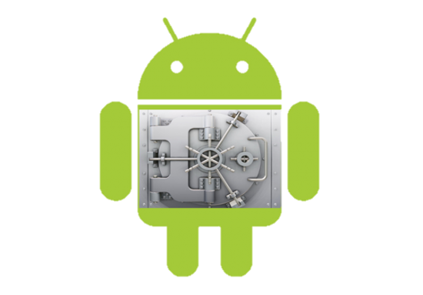
Problem Statement
Attempt to write a software TPM on an Android OS
To accomplish this we will use an ARM security extension called TrustZone
To safely test the TPM we must have an emulator
Notes:
TPM- used to increase security by making a second chip on the processor that allows “safe world” program execution

Slide 4
The Project
To implement a software stack that allows the emulation of the Android operating system to use the functionality of ARM’s TrustZone
This is a proof of concept project for The Boeing Corporation so they can begin development with TrustZone

Slide 5
TrustZone
ARM’s processor extension that allows for a software TPM implementation
Available on all major ARM cell phone chips
There is limited open source development with TrustZone

Slide 6
TPM Overview
A TPM is a chip that resides on the motherboard, and provides 4 basic functionalities
Secure storage and reporting of platform configurations
Protected private key storage
Cryptographic functions
Initialization and management functions

Slide 7
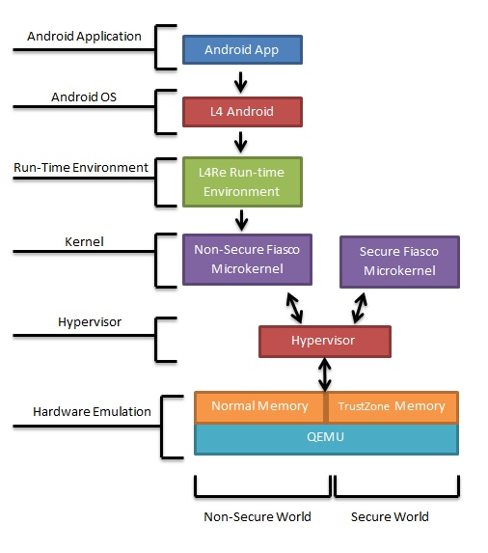
New Software Stack

Slide 8
QEMU
Open source hardware emulator used by Android developers
Main release does not contain TrustZone emulation capabilities
Johannes Winter is a computer scientist who modified QEMU for his own research so it can emulate TrustZone

Slide 9
Hypervisor
Will communicate between QEMU and our two kernels, doing the context switching between them
We are still testing which one we would like to use
NOVA, Choices, custom

Slide 10
Fiasco Microkernel
Developed by a group at TU-Dreseden
This is the only software that will run in the privileged or secure mode of the processor
Very small for security purposes

Slide 11
L⁴Runtime Environment
Offers a concise set of interfaces for building applications
Comprised of low-level software components that interface directly with the microkernel
Libraries and interfaces are provided and object oriented

Slide 12
L⁴Android
Derived from the L⁴Linux project which is developed at TU-Dresden
Designed specifically to work with Fiasco.OC microkernel
Currently runs as Android version 2.2 (Froyo) or 2.3 (Gingerbread)

Slide 13
Android Application
The highest part of the stack will be a program we write that uses TrustZone’s TPM features
Application will make TrustZone calls to the microkernel

Slide 14
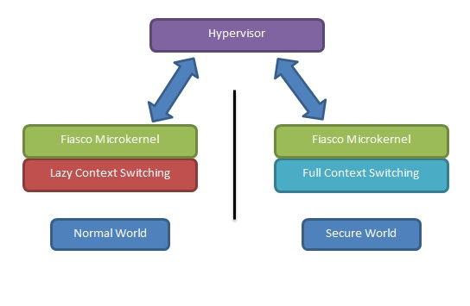
Difference is in Memory
Only write to memory when needed, better performance
Overwrite memory after every context switch, better security

Slide 15
Development Environment
Host OS: Windows Server 2008
VM Software: VMWorkstation
VM OS: Debian 6.0

Slide 16
Things to accomplish
1) Pick out hypervisor
2) Get context switching between worlds
3) Add the TrustZone extension to the software that needs it
4)Write the Android app to test

