Slide 1
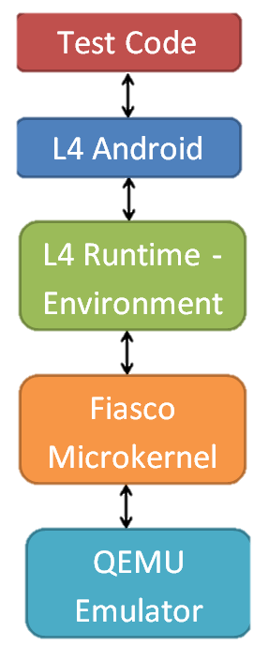
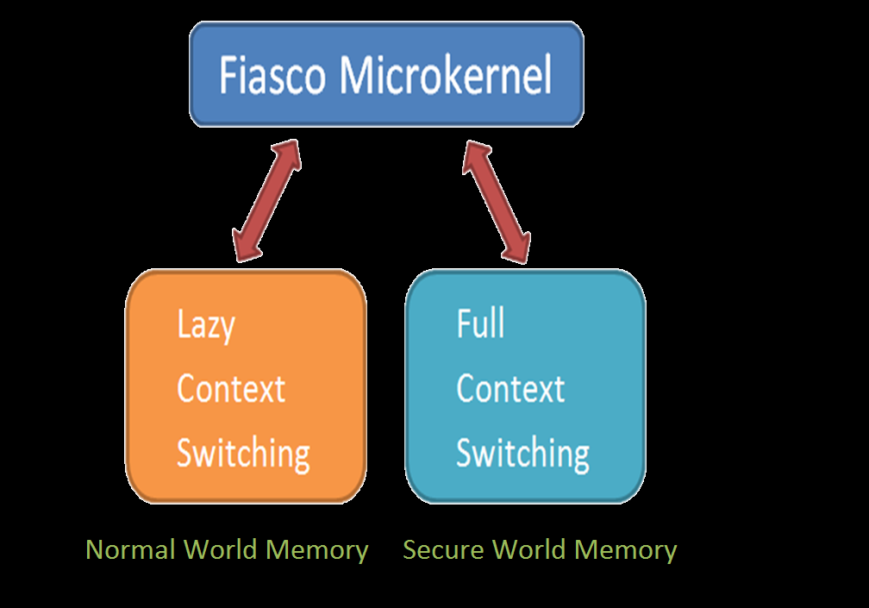
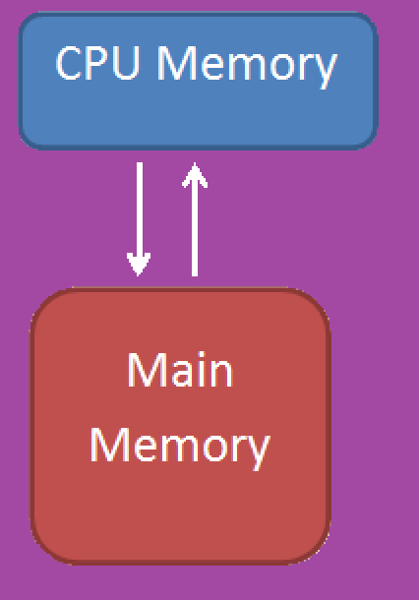
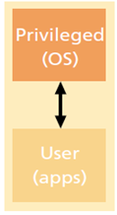
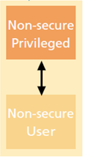
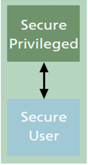
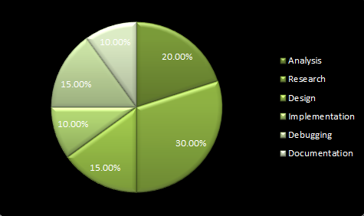
Android Security Through ARM TrustZone Emulation
Senior Design May 12-08
Abstract
Design
Our project is to develop a working emulator for an Android device so that it is able to accurately represent the security extension of the device’s CPU, known as ARM TrustZone. Using TrustZone, we will provide a Trusted Platform Module (TPM) service.
As of right now, there are no commercial Android emulators that can correctly model the ARM TrustZone. Therefore, application developers are forced to test their devices on actual hardware to see if their code works. This is both dangerous to the device and time consuming. The logical next step is to try and emulate the inner workings of this hardware so that developers can then start writing applications to use it.
ARM TrustZone works by providing two virtual processors backed by hardware based access control. This enables the application core to switch between two states, referred to a worlds, in order to prevent information from leaking from the more trusted world (secure world) to the less secure world (non-secure world).
The way we approached this problem was by constructing a software stack consisting of a hardware emulator, a microkernel, a run-time environment, and the Android OS. We made necessary modifications to different layers in the stack to allow TrustZone support.
Requirements
QEMU – a powerful processor emulator that uses dynamic binary translation to allow it to be ported to many different CPU architectures. The hardware emulation of the ARM TrustZone is implemented here.
Fiasco Microkernel – software needed to implement the runtime environment that will run on top of it, this is the only piece of software that will run in the secure world of the processor. The memory management unit of Fiasco has been modified to implement the memory separation required.
Fiasco L4Re – provides a basic set of services and abstractions, which will be used to implement and run applications on top of the microkernel.
L4 Android – an operating system developed to run on top of the Fiasco L4Re run-time environment, provides a layer for us to develop applications on top of.
Functional
Non-Functional
Fiasco.OC microkernel will run seamlessly over Mr.Winter’s QEMU
L4RE will run seamlessly over Fiasco.OC
The L4Android will run seamlessly over L4RE
An Android application will use the TPM services provided
Modifications made to any components of the stack will not adversely affect existing functionality
The stack will provide the user with a secure environment
The stack will run at a usable speed
The stack will be stable and run reliably
Modifications to QEMU, Fiasco.OC and L4Re will be written in C and ++
Developed applications will use TrustZone and our TPM services in real time
Our software stack will allow TPM services to be added later
Context Switch
Full Context Switch (Secure World)
On context switch:
1) Write back all modified CPU memory
2) Zero out before switching
Attributes: More performance overhead but more secure
Users
Environments Used
Android Application developers
Anyone interested in TrustZone
GCC
ARM GCC
Lazy Context Switch (Normal World)
On context switch:
1) Only write back if CPU memory is modified or page fault occurs
Attributes: Less overhead but also less secure
TrustZone
ARM TrustZone is a security extension to the CPU that provides two virtual processors backed by hardware based access control. TrustZone splits the CPU into two worlds, the secure world and the non-secure world. It ensures that nothing from the secure world can be accessed by the non-secure world. It is available on all of ARM’s advanced chipsets.
Process of a Context Switch
Applications
The process to context switch from the normal world to the secure world and back to the normal world is as follows:
Executing application requests a context switch to Fiasco MMU, SMC bit set
Once the Fiasco microkernel receives the request a masked FIQ interrupt is thrown, this gives control to the secure world
If the application has previous saved data in the secure memory, the Fiasco MMU loads that memory into the CPU
Secure section of application executes
Processor memory saved in secure world memory
Masked IRQ interrupt is thrown, this gives control back to the normal world
• Secure PIN entry
• Digital Rights Management
• Software license management
• e-Ticketing Mobile TV (Netflix)
TrustZone adds a “parallel world” to allow trusted programs and data to be safely separated from the operating system and applications
Work Breakdown
Tools Used
Cross Compiler
CodeSourcery
This cross compiler was needed because all the software we used was written for x86 processors and not the ARM processor we were to use. This compiler took the object files written for the stack and converted it to ARM object files to run on top of our ARM processor.
Programming Languages
Java is used to complete all Android applications including our secure application
C is what our QEMU emulator was written and edited in
C++ is the programming language used for Fiasco Microkernel and also for all of the L4RE components
Advisor: George Amariucai Client: The Boeing Company
Alex Frisvold Alex Meyer Nazmus Sakib Eric Van Buren

