Slide 1
Android Security
GROUP MAY 1208 Alex Frisvold Alex Meyer Nazmus Sakib Eric Van Buren

Slide 2
Advisors
Our project is through The Boeing Company and our advisor is Victor Lukasik, the manager of Boeing’s Cyber Mission Assurance group
Our faculty advisory at Iowa State is George Amariucai

Slide 3
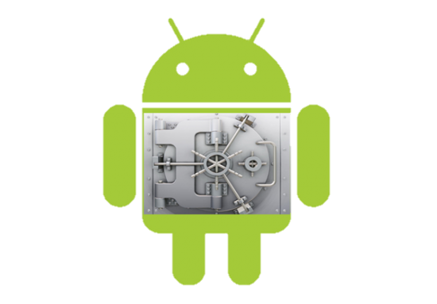
Problem Statement
Attempt a software TPM on Android
TPM-Trusted Platform Module
To safely test the TPM we must have an emulator
Notes:
TPM- used to increase security by making a second chip on the processor that allows “safe world” program execution

Slide 4
The Project
To implement a software stack that allows the emulation of the Android operating system to use the functionality of ARM’s TrustZone
This is a proof of concept project for The Boeing Corporation so they can begin development with TrustZone

Slide 5
TrustZone
ARM’s processor extension that allows for a software TPM implementation
Available on all major ARM cell phone chips
There is limited open source development with TrustZone

Slide 6
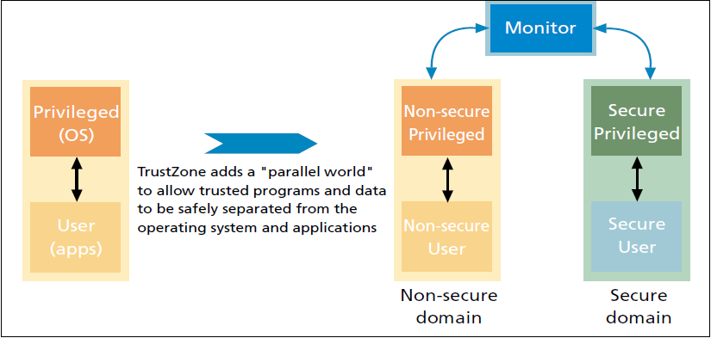
System Overview

Slide 7
Application Examples of TrustZone
Secure PIN Entry
Digital Rights Management
e-Ticketing Mobile TV (Netflix)

Slide 8
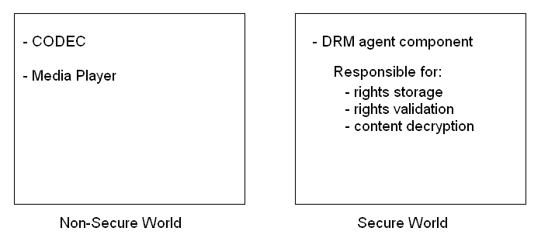
DRM Example
Notes:
Many security use cases in mobile devices are related to content management
The role of a DRM agent is to enforce the access to media content based on the rights that the user has purchased.
When a user selects a DRM protected file for playback the agent must ensure that the user’s rights are still valid and, if they are, decrypt the file and pass it to the media player.
Secure world defends the DRM agent component against malicious software.
Type of attacker in this example would be the user.

Slide 9
TPM Overview
A TPM is a chip that resides on the motherboard, and provides 4 basic functionalities
Secure storage and reporting of platform configurations
Protected private key storage
Cryptographic functions
Initialization and management functions

Slide 10
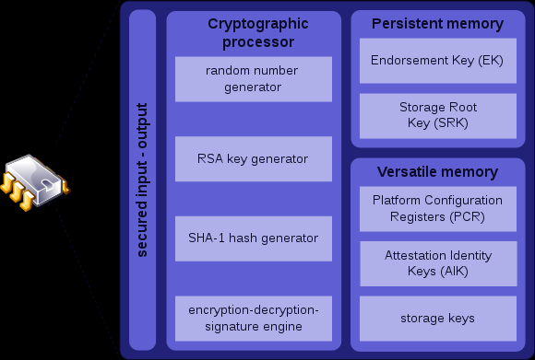

Slide 11
TrustZone Implementation
There is no open source emulator for TrustZone making development difficult
We will use 4 different open source components in one modified stack

Slide 12
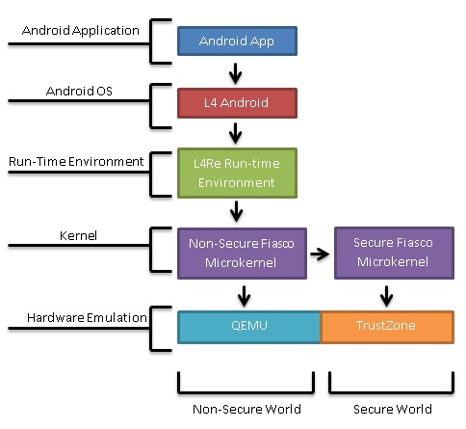
The Stack
Notes:
UPDATE

Slide 13
QEMU
Open source hardware emulator used by Android developers
Main release does not contain TrustZone emulation capabilities
Johannes Winter is a computer scientist who modified QEMU for his own research so it can emulate TrustZone

Slide 14
Fiasco Microkernel
Developed by a group at TU-Dreseden
This is the only software that will run in the privileged or secure mode of the processor
Very small for security purposes

Slide 15
L⁴Runtime Environment
Offers a concise set of interfaces for building applications
Comprised of low-level software components that interface directly with the microkernel
Libraries and interfaces are provided and object oriented

Slide 16
L⁴Android
Derived from the L⁴Linux project which is developed at TU-Dresden
Designed specifically to work with Fiasco.OC microkernel
Currently runs as Android version 2.2 (Froyo) or 2.3 (Gingerbread)

Slide 17
Android Application
The highest part of the stack will be a program we write that uses TrustZone’s TPM features
Application will make TrustZone calls to the microkernel

Slide 18
Functional Requirement
The modified FIASCO.OC microkernel will run seamlessly over Mr. Winter’s extended version of QEMU
Notes:
-Install QEMU and include any programs required that his version of QEMU uses
-Install Fiasco.OC microkernel and make the required changed
-Final test will be running an ISO image of Android on the augmented version of QEMU

Slide 19
Functional Requirement
The modified L4 runtime environment will run seamlessly over the modified Fiasco.OC microkernel
Notes:
Most modifications will most likely be done to Fiasco.OC
These changes should not effect the way Fiasco.OC performs

Slide 20
Functional Requirement
The L4Android operating system will run seamlessly over the modified L4 runtime environment

Slide 21
Functional Requirement
Our software stack will use the secure world to provide two TPM services:
Random Number Generation
RSA Key Generation

Slide 22
Functional Requirement
An Android application will be able to use the TPM services provided and will be able to perform the following tasks:
encrypt sensitive data using the secure world
decrypt sensitive data using the secure world

Slide 23
Functional Requirement
Modifications made to any of the various components of the software stack should not adversely affect any of the existing functionality of the components

Slide 24
Non-Functional Requirements
The modified software stack should run at a usable speed
The modified software stack should be stable and run reliably
Modifications to QEMU, Fiasco.OC and L4RE should be written in C and C++ programming language on a Debian Linux platform

Slide 25
Testing
Make sure that Fiasco.OC microkernel will run seamlessly over Mr. Winter’s QEMU
Context switching between worlds
Writing an Android application that uses TrustZone
Notes:
Lowest layer in the stack.
Correct installation on Johannes Winter’s QEMU
Make changes in the source code of the microkernel to port Fiasco to the augmented version of QEMU
Test by using Fiasco to create an ISO image and ten run it using the augmented version of QEMU
Context Switching
Switching between worlds is controlled by the Secure Monitor
Triggered by a dedicated instruction known as the Secure Monitor Call (SMC) instruction.
The world in which the processor is executing is indicated by the NS-bit in the Secure Configuration Register in the CP15, the system control processor.
In order to test if context switching between worlds is working correctly, we can check if the NS-bit is set.
Android Application
Potential to be the most difficult task because of the possibility that we may need to implement a complex TrustZone API.
The API will allow the application to communicate with the lower layers.
To test of the application works correctly, we will need to monitor calls that the application makes to the Secure Monitor and make sure that the context switching between worlds is working correctly.
The Fiasco microkernel acts as the secure monitor

Slide 26
Assumptions
Adequate time to complete our project
Johannes Winter’s experimental QEMU extensions function correctly
The Fiasco microkernel and L4Re will function with Johannes Winter’s QEMU

Slide 27
Constraints
April 2012 is a firm deadline for this project
The experimental nature of Johannes Winter’s QEMU release may lead to problems
There is no documentation for this stack which suggests we may be the first group to attempt this

Slide 28
Risks and Mitigations
Not Possible to Implement
Time constraints
Resources and Documentation

Slide 29
Project Milestones & Schedule
Finding Johannes Winter’s augmented QEMU made this project possible
Creating an early version of the stack

Slide 30
Plan for Next Semester
Work on creating the stack
Modify the Fiasco microkernel to support Johannes Winter’s QEMU
Testing
Writing the Android application

Slide 31
Questions?

